Slide 1
Chapter 1: Explore the Network
Introduction to Networks v5.1

Slide 2
Chapter Outline
1.0 Introduction
1.1 Globally Connected
1.2 LANs, WANs, and the Internet
1.3 The Network as a Platform
1.4 The Changing Network Environment
1.5 Summary

Slide 3
Section 1.1: Globally Connected
Upon completion of this section, you should be able to:
Explain how networks affect the way we interact, learn, work, and play.
Explain how host devices can be used as clients, servers, or both.

Slide 4
Topic 1.1.1: Networking Today

Slide 5
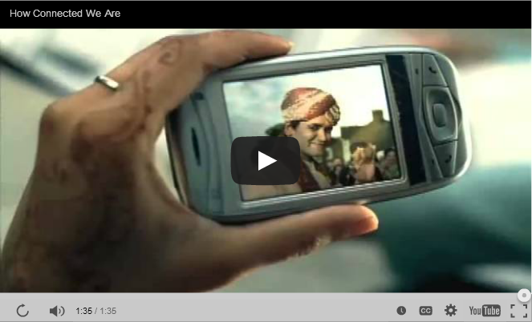
Networks in Our Daily Lives
Notes:
1.1.1.1 Networks in Our Daily Lives

Slide 6
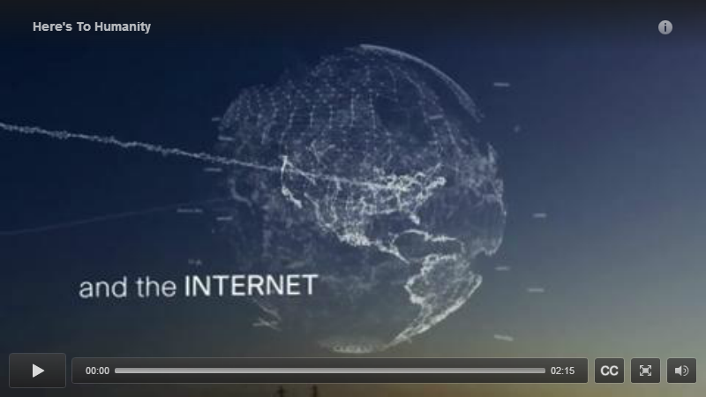
Technology Then and Now
Notes:
1.1.1.2 Technology Then and Now

Slide 7


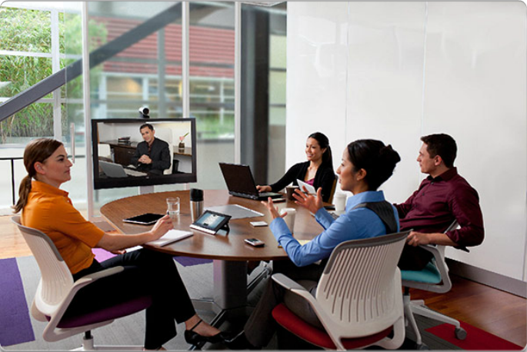
No Boundaries
Networks support the way we:
Learn
Communicate
Work
Play
Notes:
1.1.1.3 No Boundaries
1.1.1.4 Networks Support the Way We Learn
1.1.1.5 Networks Support the Way We Communicate
1.1.1.6 Networks Support the Way We Work
1.1.1.7 Networks Support the Way We Play
1.1.1.8 Lab - Researching Network Collaboration Tools

Slide 8
Topic 1.1.2: Providing Resources in a Network

Slide 9
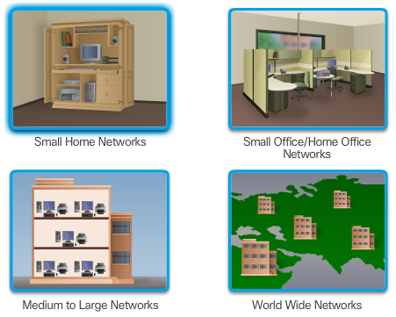
Networks of Many Sizes
Notes:
1.1.2.1 Networks of Many Sizes

Slide 10
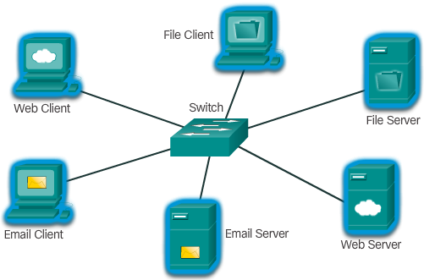
Clients and Servers
Notes:
1.1.2.2 Clients and Servers

Slide 11
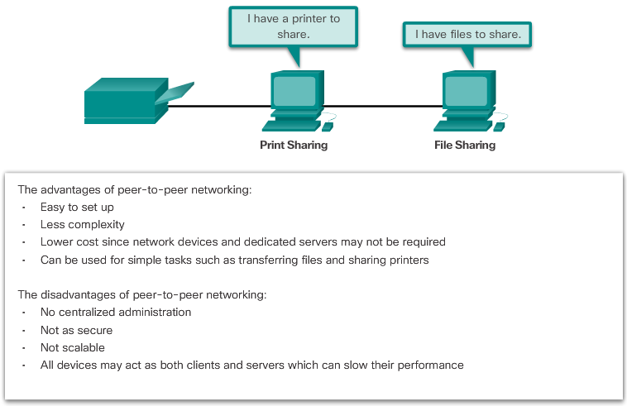
Peer-to-Peer
Notes:
1.1.2.3 Peer-to-Peer

Slide 12
Section 1.2: LANs, WANs, and the Internet
Upon completion of this section, you should be able to:
Explain the use of network devices.
Compare the devices and topologies of a LAN to the devices and topologies of a WAN.
Describe the basic structure of the Internet.
Explain how LANs and WANs interconnect to the Internet.

Slide 13
Topic 1.2.1: Network Components

Slide 14
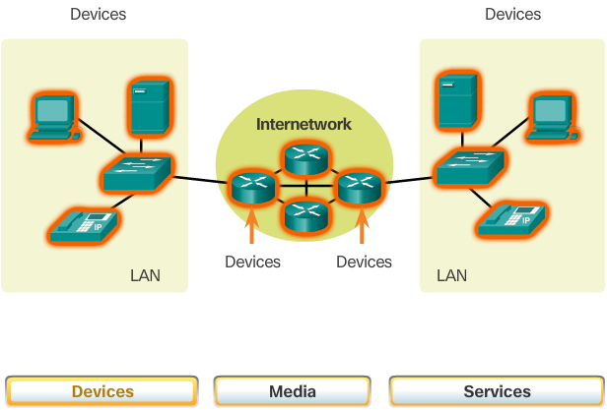
Overview of Network Components
Notes:
1.2.1.1 Overview of Network Components

Slide 15
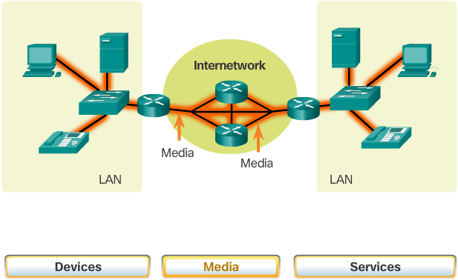
Overview of Network Components (cont.)
Notes:
1.2.1.1 Overview of Network Components (Cont.)

Slide 16
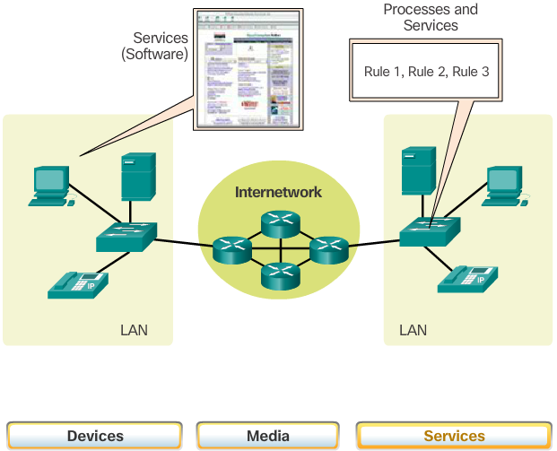
Overview of Network Components (cont.)
Notes:
1.2.1.1 Overview of Network Components (Cont.)

Slide 17
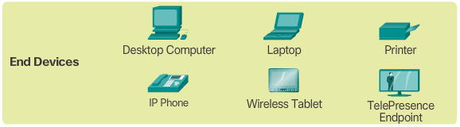
End Devices
Notes:
1.2.1.2 End Devices

Slide 18
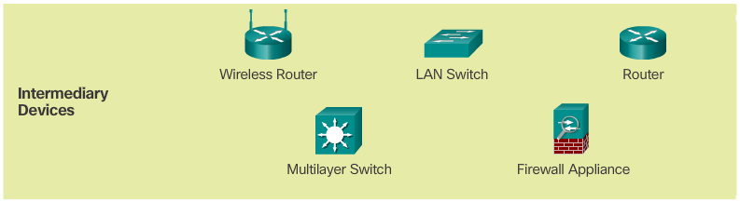
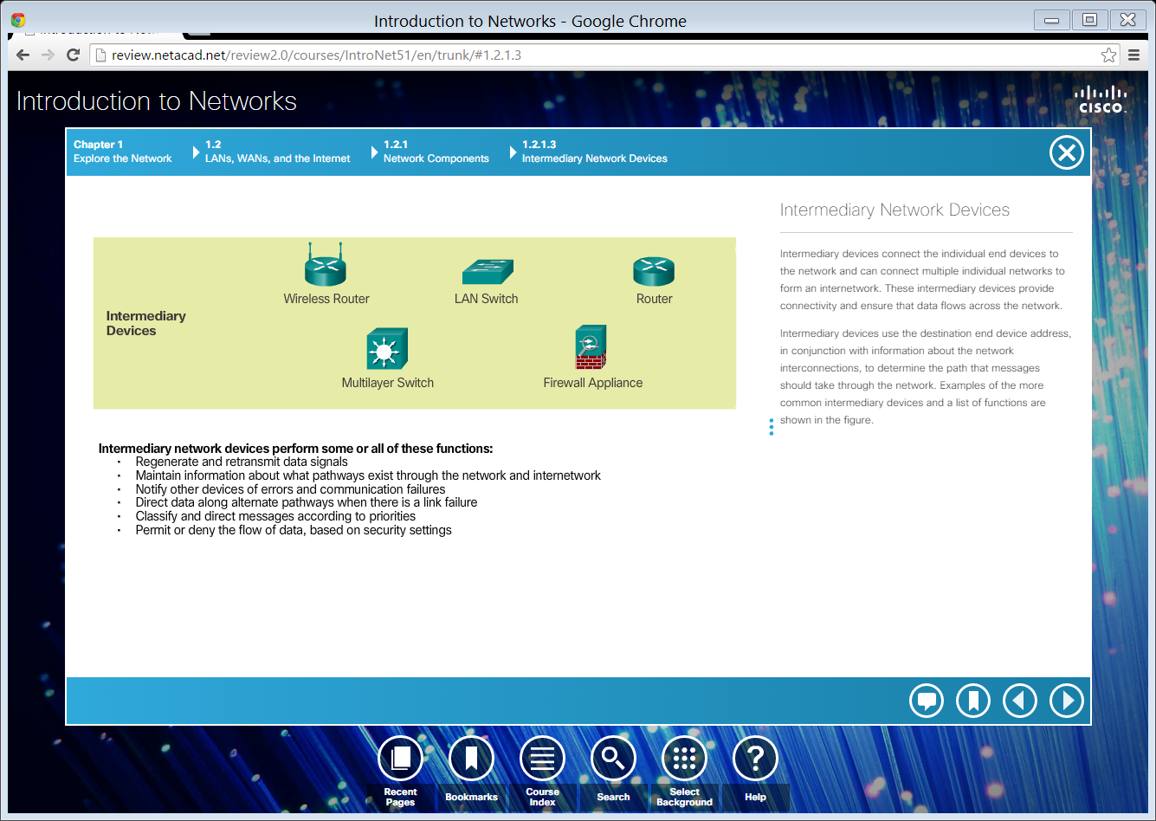
Intermediary Network Devices
Notes:
1.2.1.3 Intermediary Network Devices

Slide 19
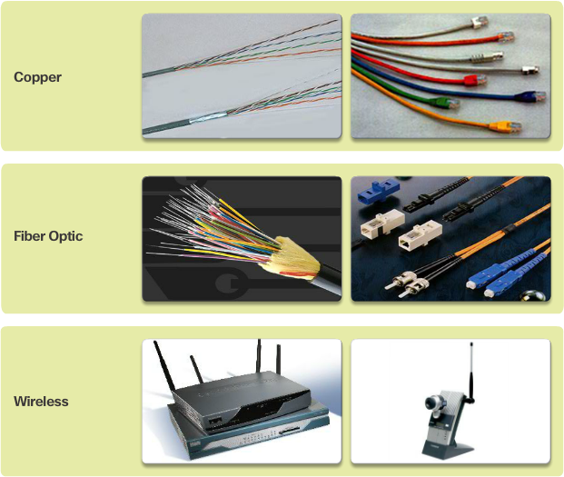
Network Media
Notes:
1.2.1.4 Network Media

Slide 20
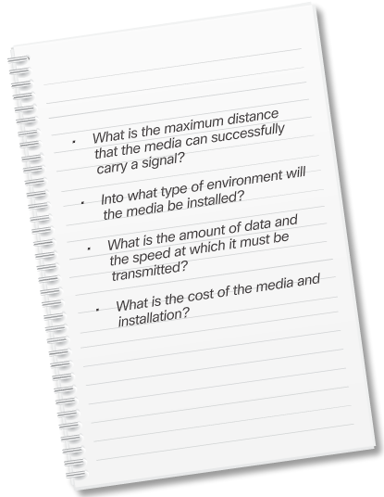
Network Media (cont.)
Notes:
1.2.1.4 Network Media (Cont.)

Slide 21
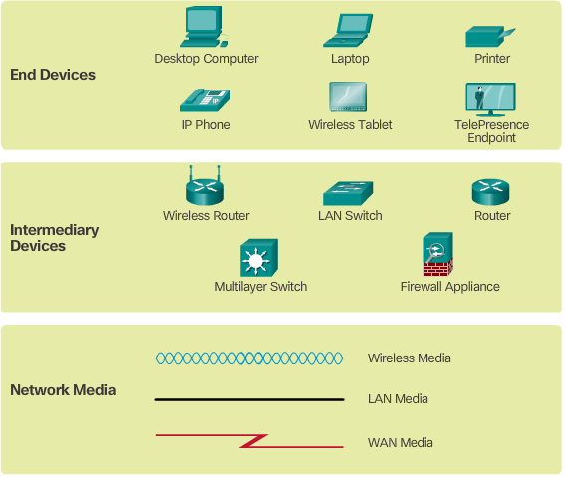
Network Representations
Notes:
1.2.1.5 Network Representations

Slide 22
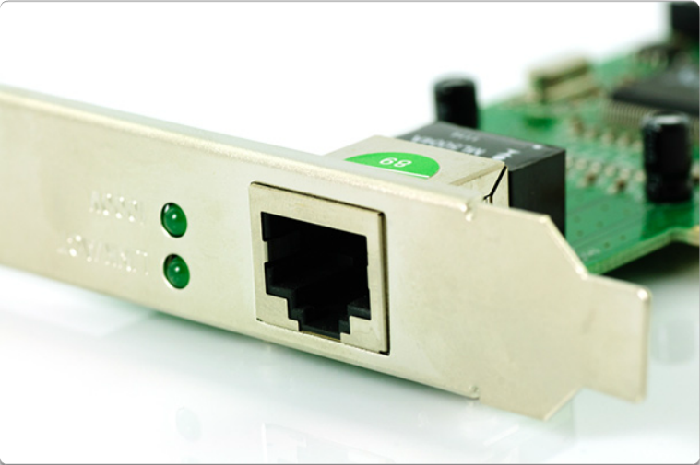
Network Representations (Cont.)
Network Interface Card
Notes:
1.2.1.5 Network Representations (Cont.)

Slide 23
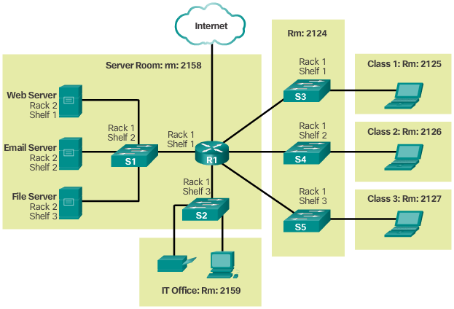
Topology Diagrams
Physical Topology
Notes:
1.2.1.6 Topology Diagrams

Slide 24
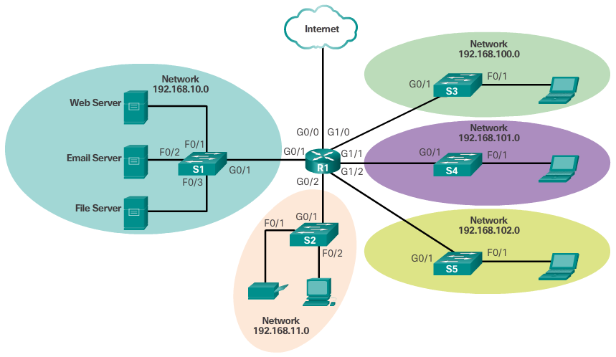
Topology Diagrams (Cont.)
Logical Topology
Notes:
1.2.1.6 Topology Diagrams (Cont.)
1.2.1.7 Activity – Network Component Representations and Fucntions

Slide 25
Topic 1.2.2: LANs and WANs

Slide 26
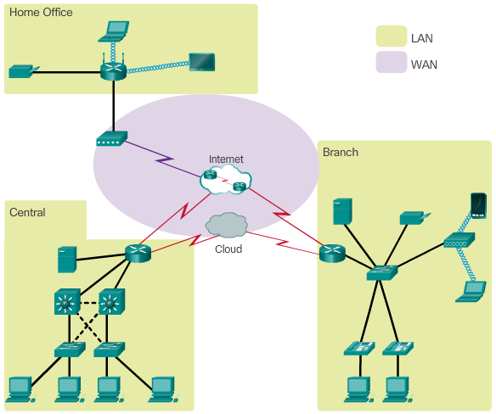
Types of Networks
Notes:
1.2.2.1 Types of Networks

Slide 27
Types of Networks
The two most common types of network infrastructures are:
Local Area Network (LAN)
Wide Area Network (WAN)
Other types of networks include:
Metropolitan Area Network (MAN)
Wireless LAN (WLAN)
Storage Area Network (SAN)
Notes:
1.2.2.1 Types of Networks (Cont.)

Slide 28
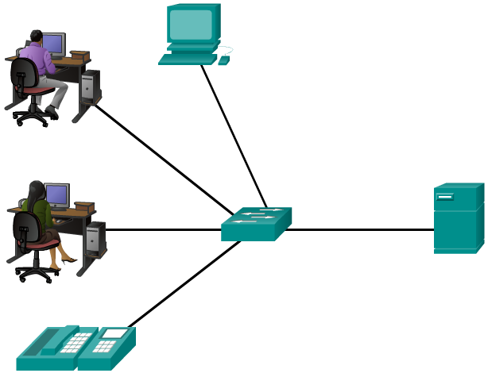
Local Area Networks
Notes:
1.2.2.2 Local Area Networks

Slide 29
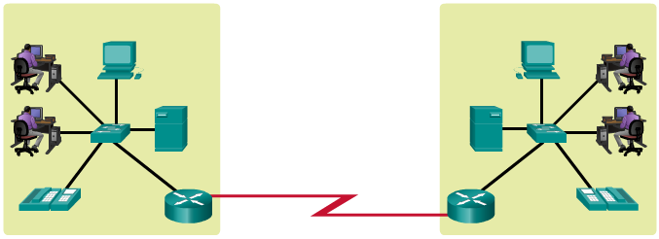
Wide Area Networks
LANs separated by geographic distance are connected by a network known as a WAN.
Notes:
1.2.2.3 Wide Area Networks

Slide 30
Topic 1.2.3: The Internet, Intranets, and Extranets

Slide 31
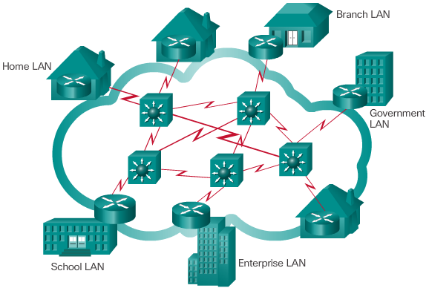
The Internet
LANs use WAN services to interconnect.
Notes:
1.2.3.1 The Internet

Slide 32
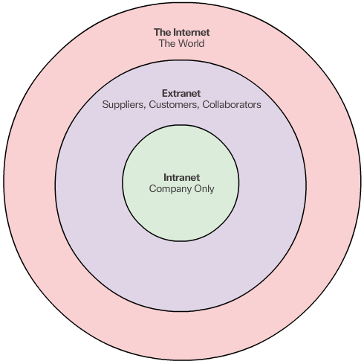
Intranets and Extranets
Notes:
1.2.3.2 Intranets and Extranets

Slide 33
Topic 1.2.4: Internet Connections

Slide 34

Internet Access Technologies
Internet Service Provider (ISP)
Broadband cable
Broadband Digital Subscriber Line (DSL)
Wireless WANs
Mobile Services
Business DSL
Leased Lines
Metro Ethernet
Notes:
1.2.4.1 Internet Access Technologies

Slide 35
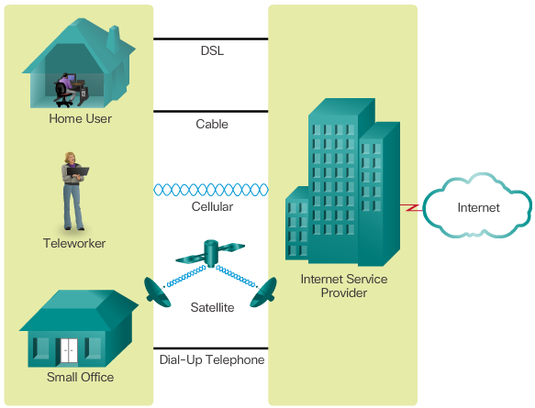
Home and Small Office Internet Connections
Notes:
1.2.4.2 Home and Small Office Internet Connections

Slide 36
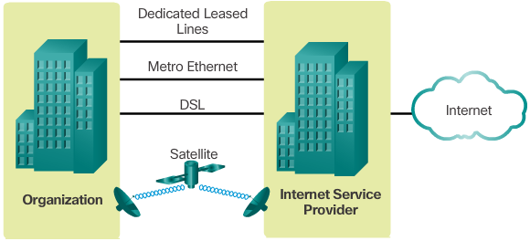
Business Internet Connections
Notes:
1.2.4.3 Business Internet Connections
1.2.4.4 Packet Tracer – Help and Navigation Tips
1.2.4.5 Packet Tracer – Network Representation

Slide 37
Section 1.3: The Network as a Platform
Upon completion of this section, you should be able to:
Explain the concept of a converged network.
Describe the four basic requirements of a reliable network.

Slide 38
Topic 1.3.1: Converged Networks

Slide 39
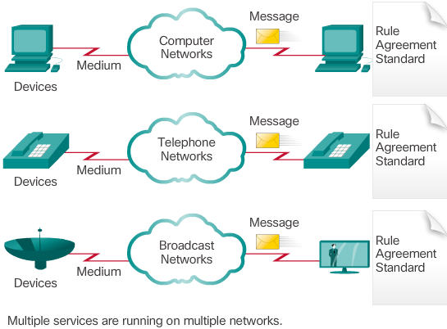
Traditional Separate Networks
Notes:
1.3.1.1 Traditional Separate Networks

Slide 40
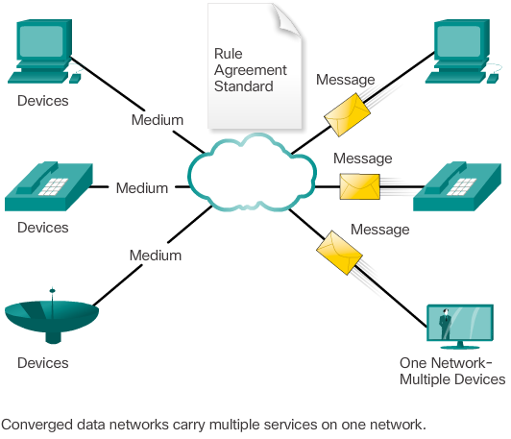
The Converging Networks
Notes:
1.3.1.2 The Converging Networks
1.3.1.3 Lab – Researching Converged Network Services

Slide 41
Topic 1.3.2: Reliable Networks

Slide 42
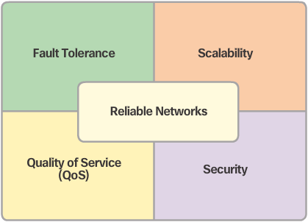
Network Architecture
Notes:
1.3.2.1 Network Architecture

Slide 43
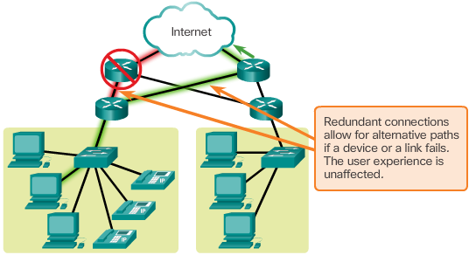
Fault Tolerance
Notes:
1.3.2.2 Fault Tolerance

Slide 44
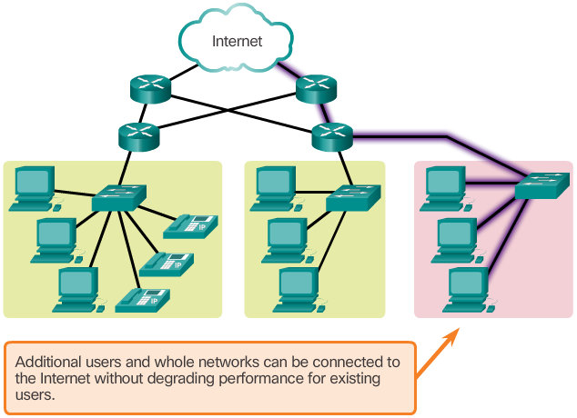
Scalability
Notes:
1.3.2.3 Scalability

Slide 45
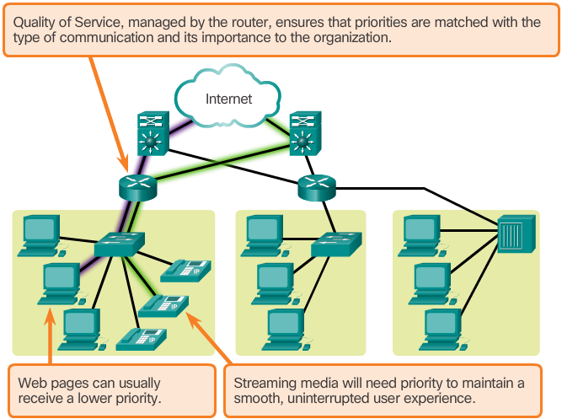
Quality of Service
Notes:
1.3.2.4 Quality of Service

Slide 46
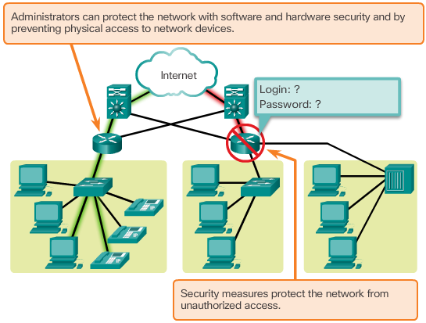
Security
Notes:
1.3.2.5 Security

Slide 47
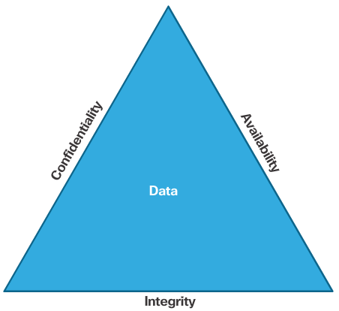
Security (cont.)
Notes:
1.3.2.5 Security (Cont.)
1.3.2.6 Activity – Network Architecture Requirements

Slide 48
Section 1.4: The Changing Network Environment
Upon completion of this section, you should be able to:
Explain how trends such as BYOD, online collaboration, video, and cloud computing are changing the way we interact.
Explain how networking technologies are changing the home environment.
Identify basic security threats and solutions for both small and large networks.
Describe the importance of understanding the underlying switching and routing infrastructure of a network.

Slide 49
Topic 1.4.1: Network Trends

Slide 50

New Trends
Top trends include:
Bring Your Own Device (BYOD)
Online collaboration
Video communications
Cloud computing
Notes:
1.4.1.1 New Trends

Slide 51

Bring Your Own Device
Notes:
1.4.1.2 Bring Your Own Device

Slide 52

Online Collaboration
Notes:
1.4.1.3 Online Collaboration

Slide 53
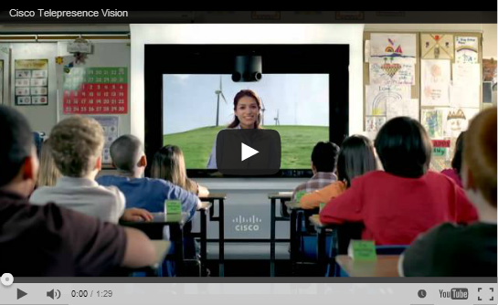
Video Communication
Notes:
1.4.1.4 Video Communication

Slide 54
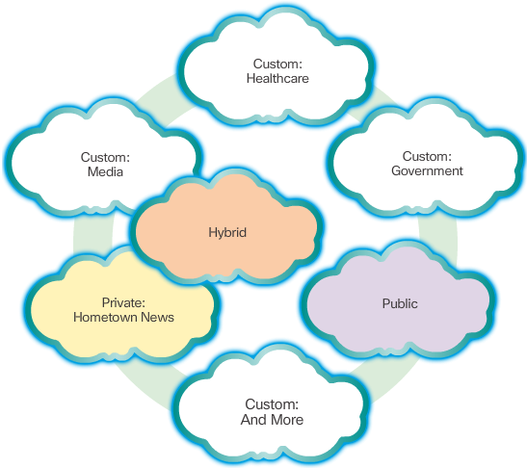
Cloud Computing
Notes:
1.4.1.5 Cloud Computing

Slide 55
Topic 1.4.2: Networking Technologies for the Home

Slide 56
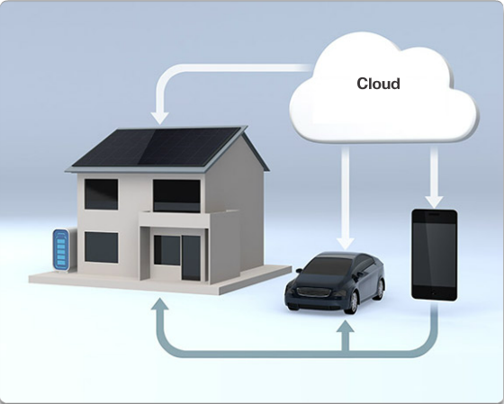
Technology Trends in the Home
Notes:
1.4.2.1 Technology Trends in the Home

Slide 57
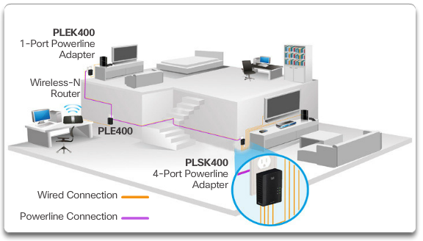
Powerline Networking
Notes:
1.4.2.2 Powerline Networking

Slide 58
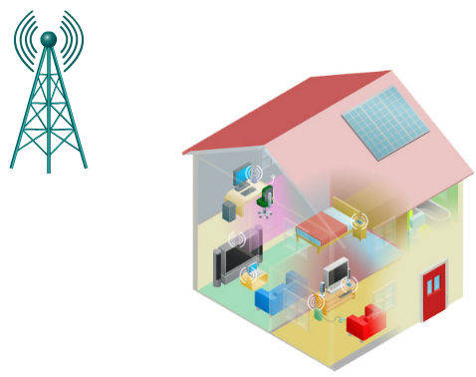
Wireless Broadband
Notes:
1.4.2.3 Wireless Broadband

Slide 59
Topic 1.4.3: Network Security

Slide 60
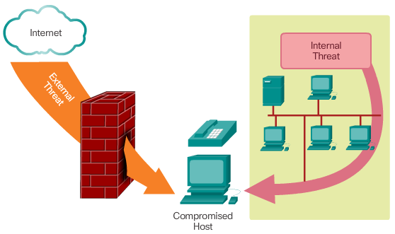
Security Threats
Notes:
1.4.3.1 Security Threats

Slide 61
Security Threats
The most common external threats to networks include:
Viruses, worms, and Trojan horses
Spyware and adware
Zero-day attacks, also called zero-hour attacks
Hacker attacks
Denial of service attacks
Data interception and theft
Identity theft
Notes:
1.4.3.1 Security Threats (Cont.)

Slide 62
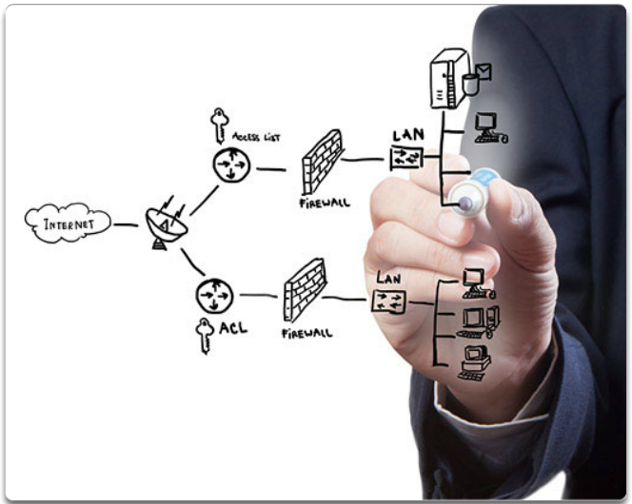
Security Solutions
Minimum solutions:
Antivirus and antispyware
Firewall filtering
Additional solutions:
Dedicated firewall systems
Access control lists (ACL)
Intrusion prevention systems (IPS)
Virtual Private Networks (VPNs)
Notes:
1.4.3.2 Security Solutions
1.4.3.3 Activity – Identify Network Security Terminology

Slide 63
Topic 1.4.4: Network Architecture

Slide 64
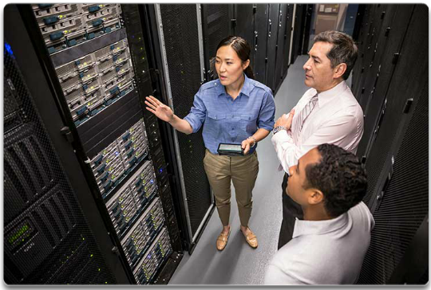
Cisco Network Architecture
Notes:
1.4.4.1 Cisco Network Architecture

Slide 65
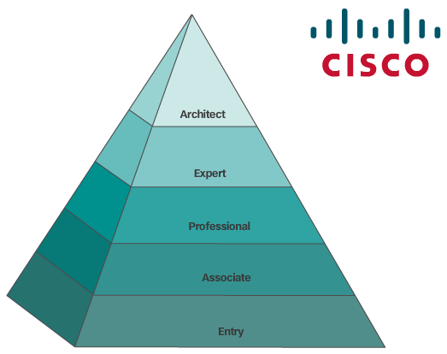
CCNA
Notes:
1.4.4.2 CCNA
1.4.4.3 Lab – Researching IT and Networking Job Opportunities

Slide 66
Section 1.5: Summary
Chapter Objectives:
Explain how multiple networks are used in everyday life.
Describe the topologies and devices used in a small to medium-sized business network.
Explain the basic characteristics of a network that supports communication in a small to medium-sized business.
Explain trends in networking that will affect the use of networks in small to medium-sized businesses.
Notes:
1.5.1.1 Class Activity – Draw Your Concept of the Internet Now
1.5.1.2 Video - Warriors of the Net
1.5.1.3 Chapter 1: Exploring the Network

